Slide 1
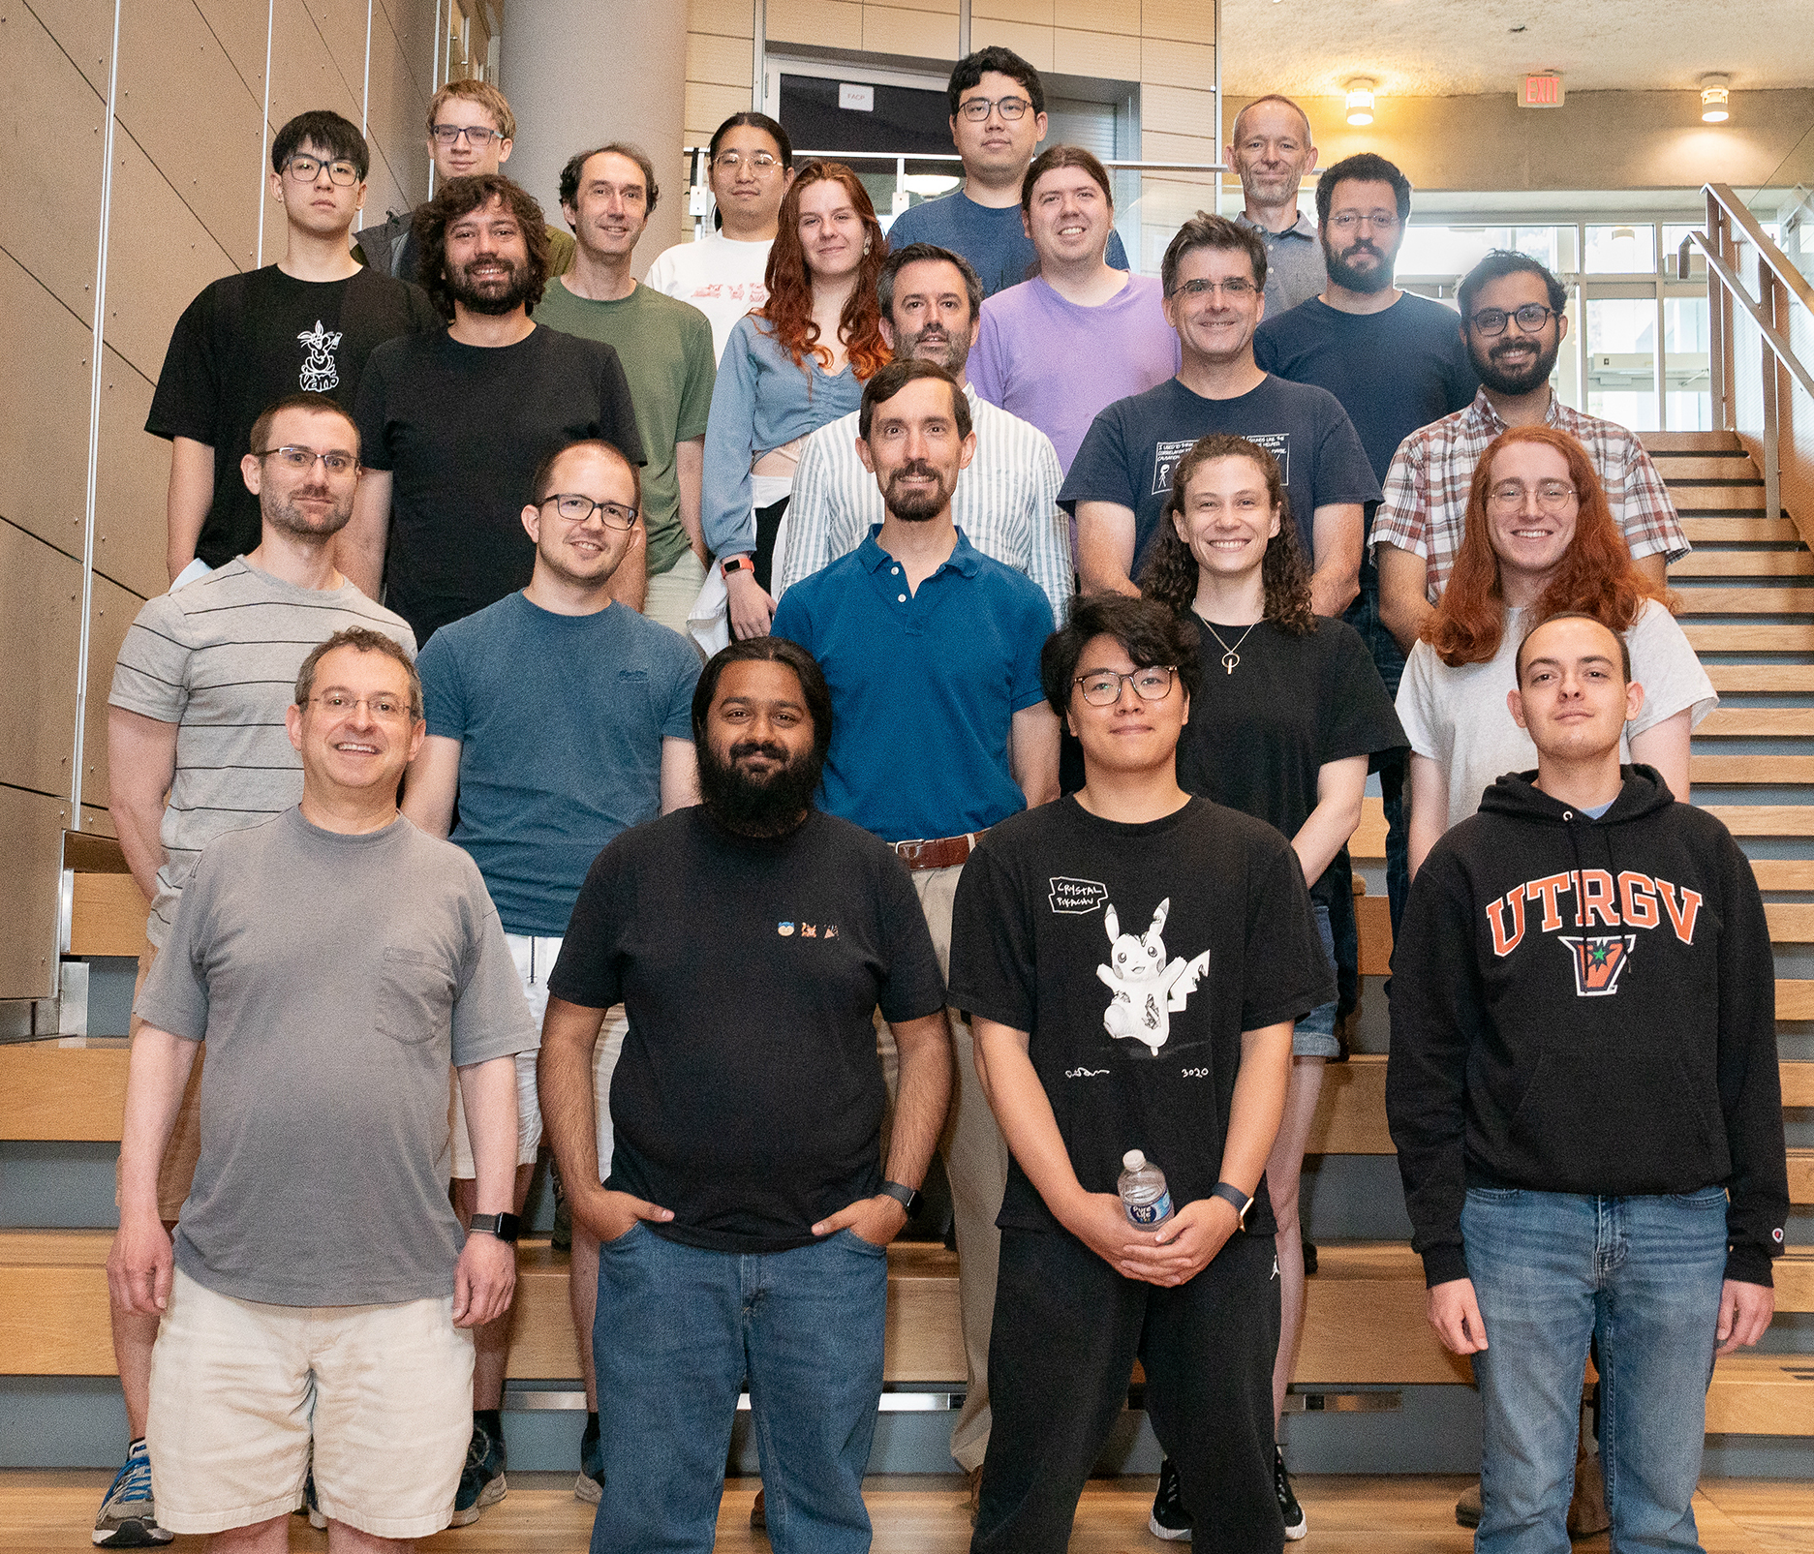

Segment Title
Your Name (and the Verus Team)
Your Affiliation
https://verus.rs/

